Slide 1
Examples Resonance, Gain & Filters
EETC 1314

Slide 2
Resonance Circuit
10Ω
0º
Volts
10mH
Consider the circuit:
Determine the resonant frequency of the circuit in both radians per second and hertz.
Determine the impedance at resonance. Z_{T} = R + j(X_{L} – X_{C})
Calculate the current at resonance.
1μF

Slide 3
Resonance Circuit
10Ω
0º
Volts
10mH
Consider the circuit:
Solve for the voltages across each circuit element at resonance. V_{R} = I(R) V_{L} = I(jX_{L}) V_{C} = I(-jX_{C})
Calculate the Qualify factor.
1μF
Q=X_{L}/R = ωL/R

Slide 4
Resonance Circuit
10Ω
0º
Volts
10mH
Consider the circuit:
Calculate the Bandwidth (rad/s).
Calculate the half-power frequencies (rad/s).
1μF

Slide 5


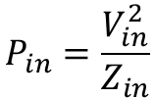



Gain
+
V_{in}
-
Z_{in}
+
V_{out}
-
R_{L}
Given an amplifier with an input impedance of Z_{in} = 2kΩ and load impedance of R_{L} = 500Ω. Find the voltage gain and power gain as both a linear ratio and in dB for the following conditions:
V_{in} = 10mV, P_{out}=400mW
$$P_{in}=\frac{V_{in}^{2}}{Z_{in}}$$
$$P_{out}=\frac{V_{out}^{2}}{R_{L}}$$
$$A_{v}=\frac{V_{out}}{V_{in}}$$
$$A_{v(dB)}=20\log{\frac{V_{out}}{V_{in}}}$$
$$A_{P}=\frac{P_{out}}{P_{in}}$$
$$A_{P(dB)}=10\log{\frac{P_{out}}{P_{in}}}$$

Slide 6
Gain
+
V_{in}
-
Z_{in}
+
V_{out}
-
R_{L}
Given an amplifier with an input impedance of Z_{in} = 2kΩ and load impedance of R_{L} = 500Ω. Find the voltage gain and power gain as both a linear ratio and in dB for the following conditions:
V_{in} = 10mV, P_{out}=400mW
$$P_{in}=\frac{V_{in}^{2}}{Z_{in}}$$
$$P_{out}=\frac{V_{out}^{2}}{R_{L}}$$
$$A_{v}=\frac{V_{out}}{V_{in}}$$
$$A_{v(dB)}=20\log{\frac{V_{out}}{V_{in}}}$$
$$A_{P}=\frac{P_{out}}{P_{in}}$$
$$A_{P(dB)}=10\log{\frac{P_{out}}{P_{in}}}$$
dB Gains

Slide 7


Low Pass Filter
A low pass filter is a circuit that allows frequencies below the cutoff frequency to pass. This circuit is excellent for rejecting high frequency noise or unwanted high frequency signals.
There are two basic types of Low Pass Filters:
RC Low Pass
RL Low Pass
$$ω_{c}=\frac{1}{RC}$$
$$ω_{c}=\frac{R}{L}$$
R
L
V_{in}(ω)
C
V_{out}(ω)
V_{in}(ω)
R
V_{out}(ω)
TF =
TF =

Slide 8
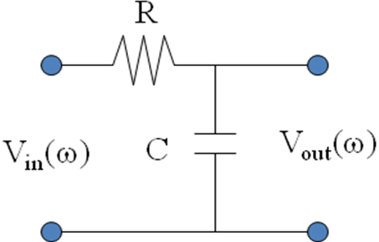
Low Pass Filters
For the circuit shown R=2kΩ and C=80nF, a) find the cutoff frequency in rad/s, b) write the Transfer Function and c) sketch the straight-line Bode plot approximation.

Slide 9
High Pass Filter
A high pass filter is a circuit that allows frequencies above the cutoff frequency to pass. This circuit is excellent for rejecting low frequency signals.
There are two basic types of High Pass Filters:
RC High Pass
RL High Pass
$$ω_{c}=\frac{1}{RC}$$
$$ω_{c}=\frac{R}{L}$$
R
C
V_{in}(ω)
R
V_{out}(ω)
V_{in}(ω)
V_{out}(ω)
L
TF =
TF =

Slide 10
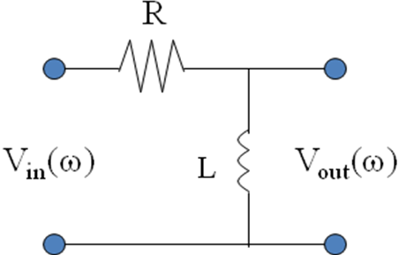
High Pass Filters
For the circuit shown R=20kΩ and L=8H, a) find the cutoff frequency in rad/s, b) write the Transfer Function and c) sketch the straight-line Bode plot approximation.

Slide 11
Resonance Circuit Formulas
Resonant frequency of the circuit in both radians per second and hertz.
Impedance at resonance
Z_{T} = R + j(X_{L} – X_{C})
Current at resonance
Voltages across each circuit element at resonance
V_{R} = I(R)
V_{L} = I(jX_{L})
V_{C} = I(-jX_{C})
Qualify factor
Bandwidth
Half-power frequencies
Q=X_{L}/R = ωL/R
BW=ω₂ – ω₁(rad/sec) = f₂ – f₁ (Hz)
OR

Slide 12


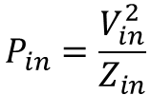



Gain Formulas
+
V_{in}
-
Z_{in}
+
V_{out}
-
R_{L}
$$P_{in}=\frac{V_{in}^{2}}{Z_{in}}$$
$$P_{out}=\frac{V_{out}^{2}}{R_{L}}$$
$$A_{v}=\frac{V_{out}}{V_{in}}$$
$$A_{v(dB)}=20\log{\frac{V_{out}}{V_{in}}}$$
$$A_{P}=\frac{P_{out}}{P_{in}}$$
$$A_{P(dB)}=10\log{\frac{P_{out}}{P_{in}}}$$

Slide 13


Filters
Cutoff Frequencies (rad/s)
RC Low Pass RL Low Pass
RC High Pass RL High Pass
$$ω_{c}=\frac{1}{RC}$$
$$ω_{c}=\frac{R}{L}$$
TF =
TF =
TF =
TF =

